Slide 1
Sets
CS 202, Spring 2007
Epp, chapter 5
Aaron Bloomfield

Slide 2
What is a set?
A set is a group of “objects”
  People in a class: { Alice, Bob, Chris }
  Classes offered by a department: { CS 101, CS 202, … }
  Colors of a rainbow: { red, orange, yellow, green, blue, purple }
  States of matter { solid, liquid, gas, plasma }
  States in the US: { Alabama, Alaska, Virginia, … }
  Sets can contain non-related elements: { 3, a, red, Virginia }
Although a set can contain (almost) anything, we will most often use sets of numbers
  All positive numbers less than or equal to 5: {1, 2, 3, 4, 5}
  A few selected real numbers: { 2.1, π, 0, -6.32, e }

Slide 3
Set properties 1
Order does not matter
  We often write them in order because it is easier for humans to understand it that way
  {1, 2, 3, 4, 5} is equivalent to {3, 5, 2, 4, 1}
Sets are notated with curly brackets

Slide 4
Set properties 2
Sets do not have duplicate elements
  Consider the set of vowels in the alphabet.
    It makes no sense to list them as {a, a, a, e, i, o, o, o, o, o, u}
    What we really want is just {a, e, i, o, u}
  Consider the list of students in this class
    Again, it does not make sense to list somebody twice
Note that a list is like a set, but order does matter and duplicate elements are allowed
  We won’t be studying lists much in this class

Slide 5
Specifying a set 1
Sets are usually represented by a capital letter (A, B, S, etc.)
Elements are usually represented by an italic lower-case letter (a, x, y, etc.)
Easiest way to specify a set is to list all the elements: A = {1, 2, 3, 4, 5}
  Not always feasible for large or infinite sets

Slide 6
Specifying a set 2
Can use an ellipsis (…): B = {0, 1, 2, 3, …}
  Can cause confusion. Consider the set C = {3, 5, 7, …}. What comes next?
  If the set is all odd integers greater than 2, it is 9
  If the set is all prime numbers greater than 2, it is 11
Can use set-builder notation
  D = {x | x is prime and x > 2}
  E = {x | x is odd and x > 2}
  The vertical bar means “such that”
  Thus, set D is read (in English) as: “all elements x such that x is prime and x is greater than 2”

Slide 7
Specifying a set 3
A set is said to “contain” the various “members” or “elements” that make up the set
  If an element a is a member of (or an element of) a set S, we use then notation a ∈ S
    4 ∈ {1, 2, 3, 4}
  If an element is not a member of (or an element of) a set S, we use the notation a ∉ S
    7 ∉ {1, 2, 3, 4}
    Virginia ∉ {1, 2, 3, 4}

Slide 8
Often used sets
N = {0, 1, 2, 3, …} is the set of natural numbers
Z = {…, -2, -1, 0, 1, 2, …} is the set of integers
Z⁺ = {1, 2, 3, …} is the set of positive integers (a.k.a whole numbers)
  Note that people disagree on the exact definitions of whole numbers and natural numbers
Q = {p/q | p ∈ Z, q ∈ Z, q ≠ 0} is the set of rational numbers
  Any number that can be expressed as a fraction of two integers (where the bottom one is not zero)
R is the set of real numbers

Slide 9
The universal set 1
U is the universal set – the set of all of elements (or the “universe”) from which given any set is drawn
  For the set {-2, 0.4, 2}, U would be the real numbers
  For the set {0, 1, 2}, U could be the natural numbers (zero and up), the integers, the rational numbers, or the real numbers, depending on the context

Slide 10
The universal set 2
  For the set of the students in this class, U would be all the students in the University (or perhaps all the people in the world)
  For the set of the vowels of the alphabet, U would be all the letters of the alphabet
  To differentiate U from U (which is a set operation), the universal set is written in a different font (and in bold and italics)

Slide 11
Venn diagrams
Represents sets graphically
  The box represents the universal set
  Circles represent the set(s)
Consider set S, which is
the set of all vowels in the
alphabet
The individual elements
are usually not written
in a Venn diagram
b
c
d
f
U
g
h
j
S
k
l
m
n
p
q
a
e
i
r
s
t
o
u
v
w
x
y
z

Slide 12
Sets of sets
Sets can contain other sets
  S = { {1}, {2}, {3} }
  T = { {1}, {{2}}, {{{3}}} }
  V = { {{1}, {{2}}}, {{{3}}}, { {1}, {{2}}, {{{3}}} } }
    V has only 3 elements!
Note that 1 ≠ {1} ≠ {{1}} ≠ {{{1}}}
  They are all different

Slide 13
The empty set 1
If a set has zero elements, it is called the empty (or null) set
  Written using the symbol ∅
  Thus, ∅ = { } ← VERY IMPORTANT
  If you get confused about the empty set in a problem, try replacing ∅ by { }
As the empty set is a set, it can be a element of other sets
  { ∅, 1, 2, 3, x } is a valid set

Slide 14
The empty set 1
Note that ∅ ≠ { ∅ }
  The first is a set of zero elements
  The second is a set of 1 element (that one element being the empty set)
Replace ∅ by { }, and you get: { } ≠ { { } }
    It’s easier to see that they are not equal that way

Slide 15

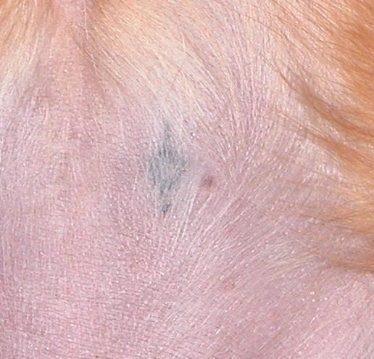

Empty set: an example

Slide 16
Set equality
Two sets are equal if they have the same elements
  {1, 2, 3, 4, 5} = {5, 4, 3, 2, 1}
    Remember that order does not matter!
  {1, 2, 3, 2, 4, 3, 2, 1} = {4, 3, 2, 1}
    Remember that duplicate elements do not matter!
Two sets are not equal if they do not have the same elements
  {1, 2, 3, 4, 5} ≠ {1, 2, 3, 4}

Slide 17
Subsets 1
If all the elements of a set S are also elements of a set T, then S is a subset of T
  For example, if S = {2, 4, 6} and T = {1, 2, 3, 4, 5, 6, 7}, then S is a subset of T
  This is specified by S ⊆ T
    Or by {2, 4, 6} ⊆ {1, 2, 3, 4, 5, 6, 7}
If S is not a subset of T, it is written as such:
S ⊆ T
  For example, {1, 2, 8} ⊆ {1, 2, 3, 4, 5, 6, 7}

Slide 18
Subsets 2
Note that any set is a subset of itself!
  Given set S = {2, 4, 6}, since all the elements of S are elements of S, S is a subset of itself
  This is kind of like saying 5 is less than or equal to 5
  Thus, for any set S, S ⊆ S

Slide 19
End of lecture on 5 February 2007

Slide 20
Subsets 3
The empty set is a subset of all sets (including itself!)
  Recall that all sets are subsets of themselves
All sets are subsets of the universal set
A horrible way to define a subset:
  ∀x ( x∈A → x∈B )
  English translation: for all possible values of x, (meaning for all possible elements of a set), if x is an element of A, then x is an element of B
  This type of notation will be gone over later

Slide 21
Proper Subsets 1
If S is a subset of T, and S is not equal to T, then S is a proper subset of T
  Let T = {0, 1, 2, 3, 4, 5}
  If S = {1, 2, 3}, S is not equal to T, and S is a subset of T
  A proper subset is written as S ⊂ T
  Let R = {0, 1, 2, 3, 4, 5}. R is equal to T, and thus is a subset (but not a proper subset) or T
    Can be written as: R ⊆ T and R ⊄ T (or just R = T)
  Let Q = {4, 5, 6}. Q is neither a subset or T nor a proper subset of T

Slide 22
Proper Subsets 2
The difference between “subset” and “proper subset” is like the difference between “less than or equal to” and “less than” for numbers
The empty set is a proper subset of all sets other than the empty set (as it is equal to the empty set)

Slide 23
Proper subsets: Venn diagram
S ⊂ R
U
R
S

Slide 24
Set cardinality
The cardinality of a set is the number of elements in a set
  Written as |A|
Examples
  Let R = {1, 2, 3, 4, 5}. Then |R| = 5
  |∅| = 0
  Let S = {∅, {a}, {b}, {a, b}}. Then |S| = 4
This is the same notation used for vector length in geometry
A set with one element is sometimes called a singleton set

Slide 25
Power sets 1
Given the set S = {0, 1}. What are all the possible subsets of S?
  They are: ∅ (as it is a subset of all sets), {0}, {1}, and {0, 1}
  The power set of S (written as P(S)) is the set of all the subsets of S
  P(S) = { ∅, {0}, {1}, {0,1} }
    Note that |S| = 2 and |P(S)| = 4

Slide 26
Power sets 2
Let T = {0, 1, 2}. The P(T) = { ∅, {0}, {1}, {2}, {0,1}, {0,2}, {1,2}, {0,1,2} }
    Note that |T| = 3 and |P(T)| = 8
P(∅) = { ∅ }
    Note that |∅| = 0 and |P(∅)| = 1
If a set has n elements, then the power set will have 2^{n} elements

Slide 27
Tuples
In 2-dimensional space, it is a (x, y) pair of numbers to specify a location
In 3-dimensional (1,2,3) is not the same as (3,2,1) – space, it is a (x, y, z) triple of numbers
In n-dimensional space, it is a
n-tuple of numbers
  Two-dimensional space uses
  pairs, or 2-tuples
  Three-dimensional space uses
  triples, or 3-tuples
Note that these tuples are
ordered, unlike sets
  the x value has to come first
+y
(2,3)
+x

Slide 28
Cartesian products 1
A Cartesian product is a set of all ordered 2-tuples where each “part” is from a given set
  Denoted by A x B, and uses parenthesis (not curly brackets)
  For example, 2-D Cartesian coordinates are the set of all ordered pairs Z x Z
    Recall Z is the set of all integers
    This is all the possible coordinates in 2-D space
  Example: Given A = { a, b } and B = { 0, 1 }, what is their Cartiesian product?
    C = A x B = { (a,0), (a,1), (b,0), (b,1) }

Slide 29
Cartesian products 2
Note that Cartesian products have only 2 parts in these examples (later examples have more parts)
Formal definition of a Cartesian product:
  A x B = { (a,b) | a ∈ A and b ∈ B }

Slide 30
Cartesian products 3
All the possible grades in this class will be a Cartesian product of the set S of all the students in this class and the set G of all possible grades
  Let S = { Alice, Bob, Chris } and G = { A, B, C }
  D = { (Alice, A), (Alice, B), (Alice, C), (Bob, A), (Bob, B), (Bob, C), (Chris, A), (Chris, B), (Chris, C) }
  The final grades will be a subset of this: { (Alice, C), (Bob, B), (Chris, A) }
    Such a subset of a Cartesian product is called a relation (more on this later in the course)

Slide 31
Cartesian products 4
There can be Cartesian products on more than two sets
A 3-D coordinate is an element from the Cartesian product of Z x Z x Z

Slide 32
Set Operations
CS 202, Spring 2007
Epp, chapter 3
Aaron Bloomfield

Slide 33

Sets of Colors
Monitor gamut (M)
Pick any 3 “primary” colors
Triangle shows mixable color range (gamut) – the set of colors
Printer
gamut (P)

Slide 34
Set operations: Union 1
Monitor gamut (M)
A union of the sets contains all the elements in EITHER set
Printer
gamut (P)
Union symbol is usually a U
Example:
C = M U P

Slide 35
Set operations: Union 2
A U B
U
A
B

Slide 36
Set operations: Union 3
Formal definition for the union of two sets:
A U B = { x | x ∈ A or x ∈ B }
Further examples
  {1, 2, 3} U {3, 4, 5} = {1, 2, 3, 4, 5}
  {New York, Washington} U {3, 4} = {New York, Washington, 3, 4}
  {1, 2} U ∅ = {1, 2}

Slide 37
Set operations: Union 4
Properties of the union operation
  A U ∅ = A Identity law
  A U U = U Domination law
  A U A = A Idempotent law
  A U B = B U A Commutative law
  A U (B U C) = (A U B) U C Associative law

Slide 38
Set operations: Intersection 1
Monitor gamut (M)
An intersection of the sets contains all the elements in BOTH sets
Printer
gamut (P)
Intersection symbol is a ∩
Example:
C = M ∩ P

Slide 39
Set operations: Intersection 2
A ∩ B
U
A
B

Slide 40
Set operations: Intersection 3
Formal definition for the intersection of two sets: A ∩ B = { x | x ∈ A and x ∈ B }
Further examples
  {1, 2, 3} ∩ {3, 4, 5} = {3}
  {New York, Washington} ∩ {3, 4} = ∅
    No elements in common
  {1, 2} ∩ ∅ = ∅
    Any set intersection with the empty set yields the empty set

Slide 41
Set operations: Intersection 4
Properties of the intersection operation
  A ∩ U = A Identity law
  A ∩ ∅ = ∅ Domination law
  A ∩ A = A Idempotent law
  A ∩ B = B ∩ A Commutative law
  A ∩ (B ∩ C) = (A ∩ B) ∩ C Associative law

Slide 42
Disjoint sets 1
Two sets are disjoint if the have NO elements in common
Formally, two sets are disjoint if their intersection is the empty set
Another example: the set of the even numbers and the set of the odd numbers

Slide 43
Disjoint sets 2
U
A
B

Slide 44
Disjoint sets 3
Formal definition for disjoint sets: two sets are disjoint if their intersection is the empty set
Further examples
  {1, 2, 3} and {3, 4, 5} are not disjoint
  {New York, Washington} and {3, 4} are disjoint
  {1, 2} and ∅ are disjoint
    Their intersection is the empty set
  ∅ and ∅ are disjoint!
    Their intersection is the empty set

Slide 45
Set operations: Difference 1
Monitor gamut (M)
A difference of two sets is the elements in one set that are NOT in the other
Printer
gamut (P)
Difference symbol is a minus sign
Example:
C = M - P
Also visa-versa:
C = P - M

Slide 46
Set operations: Difference 2
A - B
B - A
U
A
B

Slide 47
Set operations: Difference 3
Formal definition for the difference of two sets:
A - B = { x | x ∈ A and x ∉ B }
A - B = A ∩ B ← Important!
Further examples
  {1, 2, 3} - {3, 4, 5} = {1, 2}
  {New York, Washington} - {3, 4} = {New York, Washington}
  {1, 2} - ∅ = {1, 2}
    The difference of any set S with the empty set will be the set S
_

Slide 48
Set operations: Symmetric Difference 1
Monitor gamut (M)
A symmetric difference of the sets contains all the elements in either set but NOT both
Printer
gamut (P)
Symetric diff. symbol is a ⊕
Example:
C = M ⊕ P

Slide 49
Set operations: Symmetric Difference 2
Formal definition for the symmetric difference of two sets:
A ⊕ B = { x | (x ∈ A or x ∈ B) and x ∉ A ∩ B}
A ⊕ B = (A U B) – (A ∩ B) ← Important!
Further examples
  {1, 2, 3} ⊕ {3, 4, 5} = {1, 2, 4, 5}
  {New York, Washington} ⊕ {3, 4} = {New York, Washington, 3, 4}
  {1, 2} ⊕ ∅ = {1, 2}
    The symmetric difference of any set S with the empty set will be the set S

Slide 50
Complement sets 1
Monitor gamut (M)
A complement of a set is all the elements that are NOT in the set
Printer
gamut (P)
Difference symbol is a bar above the set name: P or M
_
_

Slide 51
Complement sets 2
_
A
B
U
A
B

Slide 52
Complement sets 3
Formal definition for the complement of a set: A = { x | x ∉ A }
  Or U – A, where U is the universal set
Further examples (assuming U = Z)
  {1, 2, 3} = { …, -2, -1, 0, 4, 5, 6, … }

Slide 53
Complement sets 4
Properties of complement sets
  A = A Complementation law
  A U A = U Complement law
  A ∩ A = ∅ Complement law
¯
¯
¯
¯

Slide 54
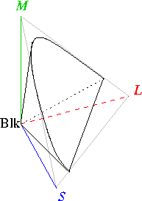

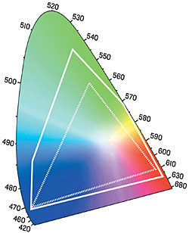

A last bit of color…

Slide 55
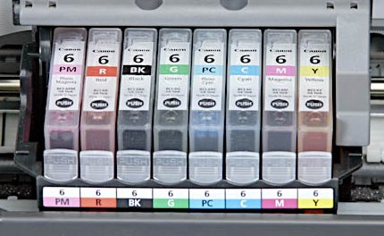
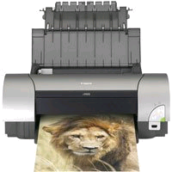
Photo printers
Photo printers use many ink colors for rich, vivid color
  Also a scam to sell you more ink (the razor business model)

Slide 56
End of lecture on 7 February 2007

Slide 57
Set identities
Set identities are basic laws on how set operations work
  Many have already been introduced on previous slides
Just like logical equivalences!
  Replace U with ∨
  Replace ∩ with ∧
  Replace ∅ with F
  Replace U with T

Slide 58
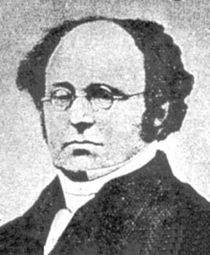
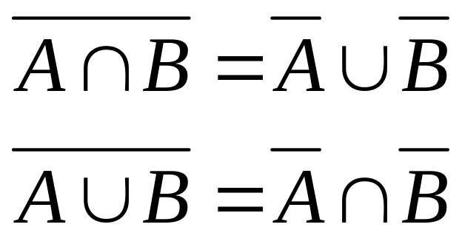
Set identities: DeMorgan again
These should look
very familiar…

Slide 59
How to prove a set identity
For example: A∩B=B-(B-A)
Four methods:
  Use the basic set identities
  Use membership tables
  Prove each set is a subset of each other
    This is like proving that two numbers are equal by showing that each is less than or equal to the other
  Use set builder notation and logical equivalences

Slide 60
What we are going to prove…
A∩B=B-(B-A)
A
B
B-(B-A)
A∩B
B-A

Slide 61
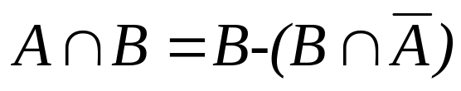
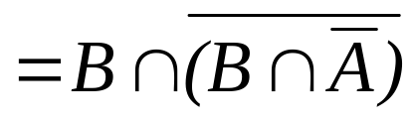
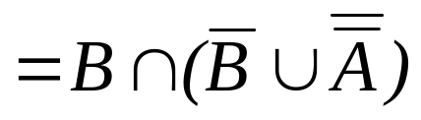
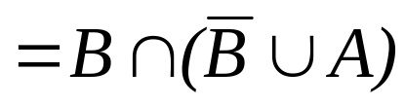
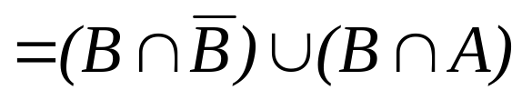



Proof by using basic set identities
Prove that A∩B=B-(B-A)
Definition of difference
Definition of difference
DeMorgan’s law
Complementation law
Distributive law
Complement law
Identity law
Commutative law

Slide 62
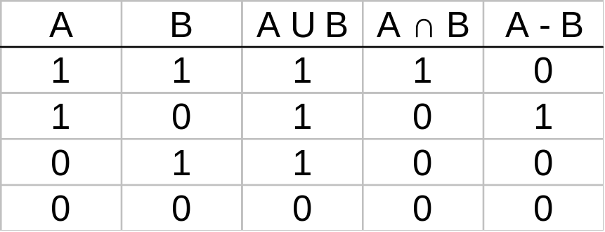
What is a membership table
Membership tables show all the combinations of sets an element can belong to
  1 means the element belongs, 0 means it does not
Consider the following membership table:
The top row is all elements that belong to both sets A and B
  Thus, these elements are in the union and intersection, but not the difference
The second row is all elements that belong to set A but not set B
  Thus, these elements are in the union and difference, but not the intersection
The third row is all elements that belong to set B but not set A
  Thus, these elements are in the union, but not the intersection or difference
The bottom row is all elements that belong to neither set A or set B
  Thus, these elements are neither the union, the intersection, nor difference

Slide 63
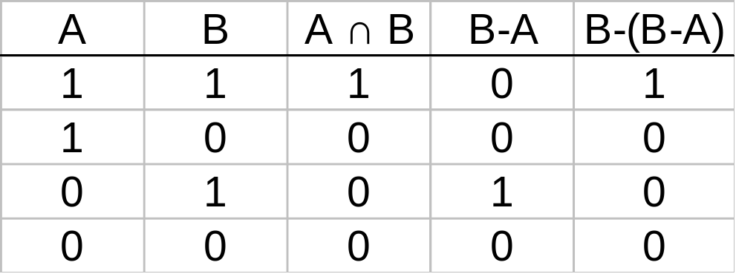
Proof by membership tables
The following membership table shows that A∩B=B-(B-A)
Because the two indicated columns have the same values, the two expressions are identical
This is similar to Boolean logic!

Slide 64
Proof by showing each set is a subset of the other 1
Assume that an element is a member of one of the identities
  Then show it is a member of the other
Repeat for the other identity
We are trying to show:
  (x∈A∩B→ x∈B-(B-A)) ∧ (x∈B-(B-A)→ x∈A∩B)
  This is the biconditional:
  x∈A∩B ↔ x∈B-(B-A)
Not good for long proofs
Basically, it’s an English run-through of the proof

Slide 65
Proof by showing each set is a subset of the other 2
Assume that x∈B-(B-A)
  By definition of difference, we know that x∈B and x∉B-A
Consider x∉B-A
  If x∈B-A, then (by definition of difference) x∈B and x∉A
  Since x∉B-A, then only one of the inverses has to be true (DeMorgan’s law): x∉B or x∈A
So we have that x∈B and (x∉B or x∈A)
  It cannot be the case where x∈B and x∉B
  Thus, x∈B and x∈A
  This is the definition of intersection
Thus, if x∈B-(B-A) then x∈A∩B

Slide 66
Proof by showing each set is a subset of the other 3
Assume that x∈A∩B
  By definition of intersection, x∈A and x∈B
Thus, we know that x∉B-A
  B-A includes all the elements in B that are also not in A not include any of the elements of A (by definition of difference)
Consider B-(B-A)
  We know that x∉B-A
  We also know that if x∈A∩B then x∈B (by definition of intersection)
  Thus, if x∈B and x∉B-A, we can restate that (using the definition of difference) as x∈B-(B-A)
Thus, if x∈A∩B then x∈B-(B-A)

Slide 67
Proof by set builder notation and logical equivalences 1
First, translate both sides of the set identity into set builder notation
Then massage one side (or both) to make it identical to the other
  Do this using logical equivalences

Slide 68








Proof by set builder notation and logical equivalences 2
Original statement
Definition of difference
Negating “element of”
Definition of difference
DeMorgan’s Law
Distributive Law
Negating “element of”
Negation Law
Identity Law
Definition of intersection

Slide 69
Proof by set builder notation and logical equivalences 3
Why can’t you prove it the “other” way?
  I.e. massage A∩B to make it look like B-(B-A)
You can, but it’s a bit annoying
  In this case, it’s not simplifying the statement

Slide 70
Computer representation of sets 1
Assume that U is finite (and reasonable!)
  Let U be the alphabet
Each bit represents whether the element in U is in the set
The vowels in the alphabet:
abcdefghijklmnopqrstuvwxyz
10001000100000100000100000
The consonants in the alphabet:
abcdefghijklmnopqrstuvwxyz
01110111011111011111011111

Slide 71
Computer representation of sets 2
Consider the union of these two sets:
    10001000100000100000100000
    ∨01110111011111011111011111
    11111111111111111111111111
Consider the intersection of these two sets:
    10001000100000100000100000
    ∧01110111011111011111011111
    00000000000000000000000000

Slide 72
Subset problems
Let A, B, and C be sets. Show that:
(AUB) ⊆ (AUBUC)
(A∩B∩C) ⊆ (A∩B)
(A-B)-C ⊆ A-C
(A-C) ∩ (C-B) = ∅

Slide 73
Russell’s paradox
Consider the set:
  S = { A | A is a set and A ∉ A }
Is S an element of itself?
Consider:
  Let S ∈ S
    Then S can not be in itself, by the definition
  Let S ∉ S
    Then S is in itself by the definition
  Contradiction!

Slide 74
Russell’s paradox
Consider the set:
  S = { A | A is a set and A ∉ A }
This shows a problem with set theory!
  Meaning we can define a set that is not viable
The solution:
  Restrict set theory to not include sets which are subsets of themselves

Slide 75
The Halting problem
Given a program P, and input I, will the program P ever terminate?
  Meaning will P(I) loop forever or halt?
Can a computer program determine this?
  Can a human?
First shown by Alan Turing in 1936
  Before digital computers existed!

Slide 76
A few notes
To “solve” the halting problem means we create a function CheckHalt(P,I)
  P is the program we are checking for halting
  I is the input to that program
And it will return “loops forever” or “halts”
Note it must work for any program, not just some programs
  Or simple programs

Slide 77
Can a human determine if a program halts?
Given a program of 10 lines or less, can a human determine if it halts?
  Assuming no tricks – the program is completely understandable
  And assuming the computer works properly, of course
And we ignore the fact that an int will max out at 4 billion

Slide 78
Halting problem tests
function haltingTest1()
print “Alan Turing”
print “was a genius”
return
function haltingTest2()
for factor from 1 to 10
print factor
return
function haltingTest3()
while ( true )
print “hello world”
return
function haltingTest4()
int x = 10
while ( x > 0 )
print “hello world”
x := x + 1
return

Slide 79
Perfect numbers
Numbers whose divisors (not including the number) add up to the number
  6 = 1 + 2 + 3
  28 = 1 + 2 + 4 + 7 + 14
The list of the first 10 perfect numbers:
6, 28, 496, 8128, 33550336, 8589869056, 137438691328, 2305843008139952128, 2658455991569831744654692615953842176, 191561942608236107294793378084303638130997321548169216
  The last one was 54 digits!
All known perfect numbers are even; it’s an open (i.e. unsolved) problem if odd perfect numbers exist
Sequence A000396 in OEIS

Slide 80
Odd perfect number search
function searchForOddPerfectNumber()
int n = 1 // arbitrary-precision integer
while (true) {
var int sumOfFactors = 0
for factor from 1 to n - 1
if factor is a factor of n
sumOfFactors = sumOfFactors + factor
if sumOfFactors = n then
break
n = n + 2
}
return
Will this program ever halt?

Slide 81
Where does that leave us?
If a human can’t figure out how to do the halting problem, we can’t make a computer do it for us
It turns out that it is impossible to write such a CheckHalt() function
  But how to prove this?

Slide 82
CheckHalt()’s non-existence
Consider P(I): a program P with input I
Suppose that CheckHalt(P,I) exists
  Tests if P(I) will either “loop forever” or “halt”
A program is a series of bits
  And thus can be considered data as well
Thus, we can call CheckHalt(P,P)
  It’s using the bytes of program P as the input to program P

Slide 83
CheckHalt()’s non-existence
Consider a new function:
  Test(P):
  loops forever if CheckHalt(P,P) prints “halts”
  halts if CheckHalt(P,P) prints “loops forever”
Do we agree that Test() is a valid function?
Now run Test(Test)
  If Test(Test) halts…
    Then CheckHalt(Test,Test) returns “loops forever”…
    Which means that Test(Test) loops forever
    Contradiction!
  If Test(Test) loops forever…
    Then CheckHalt(Test,Test) returns “halts”…
    Which means that Test(Test) halts
    Contradiction!

Slide 84
Why do we care about the halting problem?
It was the first algorithm that was shown to not be able to exist
  You can prove an existential by showing an example (a correct program)
  But it’s much harder to prove that a program can never exist

Slide 85
End of lecture on 9 February 2007

